Slide 1

Data Analyst Job MARKET
Website Development
Project 3
10/9/21
Notes:
What does a data analyst do?
The data analyst serves as a gatekeeper for an organization's data so stakeholders can understand data and use it to make strategic business decisions.

Slide 2

Introduction
Team
Technologies/Data Source
Project Overview
Development Process
Website
Summary

Slide 3

Introduction
So You Are Looking For A Data Analyst Job?
The pandemic resulted in many people losing and looking for jobs. The Data Analyst Job Search Website makes it possible to target your job search based on:
Location
Salary
Sector
Notes:
The purpose of this project is to analyze the factors which impact salaries in the field of data analytics and to use this information to create a website to assist job seekers in their research.
It’s no secret that the novel coronavirus 2019 (COVID-19) outbreak is deeply affecting the lives of millions around the world, both directly and indirectly. The United States alone has shed nearly 10 million jobs in the past two weeks due to the COVID-19 shutdown.
However, surveys indicate that the data teams are long yet to see widespread layoffs or furloughs at this time, particularly among larger companies. So, strike at the jobs while it lasts?
We have created a website that precisely helps people look for data analyst jobs nationwide. Our website lets users get whole picture of data analysts job openings nationwide, including size of employer, location, industry and estimated salary range.

Slide 4





Technologies/Data Source
Kaggle Dataset – Data Analyst Jobs
2253 job listings scraped from Glassdoor
Created 7/14/2020
Notes:
For our website, we used data analyst job postings dataset from Kaggle, which contains data of salary estimate, location, company rating, job description and more for job in the United States. Our dataset had more than 2000 rows and 16 columns. While going through our data we were able to decide that we will do visualizations around job opening by location, employer's size and estimated range of salary.
## Application:
Python (Jupyter Notebook, Pandas)
JavaScript Libraries (Plotly, Leaflet)
HTML/ CSS
Excel

Slide 5




Meet The Team
MICHELLE DAVIS
YUQING HUANG
DAWN WASHINGTON
CODY GARDNER

Slide 6

Project Overview
Clean the Kaggle Dataset
Create Visualizations – Python, Plotly
Create Webpages - HTML/CSS
Load Website - GitHub Pages
Let’s Dive In
Notes:
Start with questions
Get the data you need
Choose how to visualize the data
View and explore it
Develop insights
Act on and share your findings

Slide 7
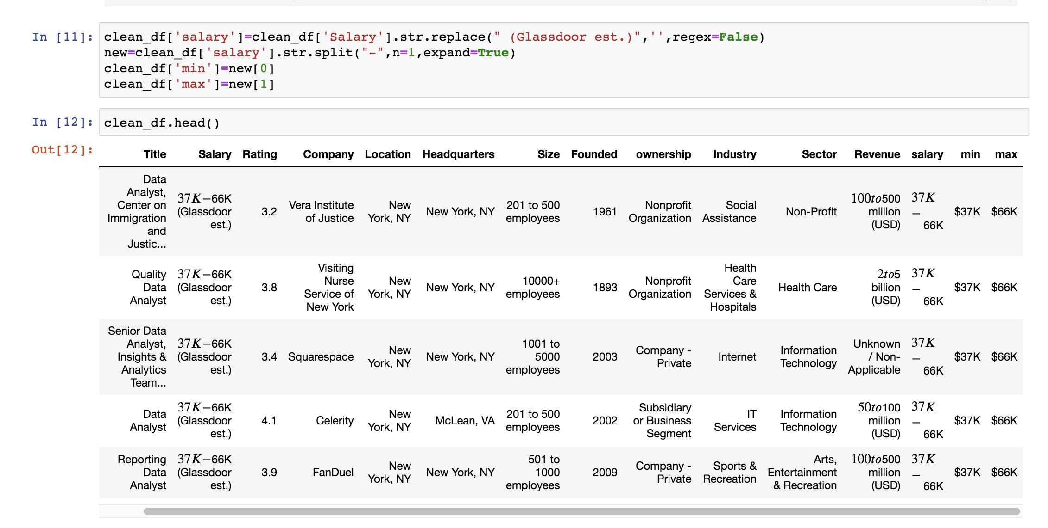
Data Cleaning
Notes:
We cleaned the data in jupyter notebook to allow for EDA. 80% of their time cleaning and manipulating data and only 20% of their time analyzing it.

Slide 8
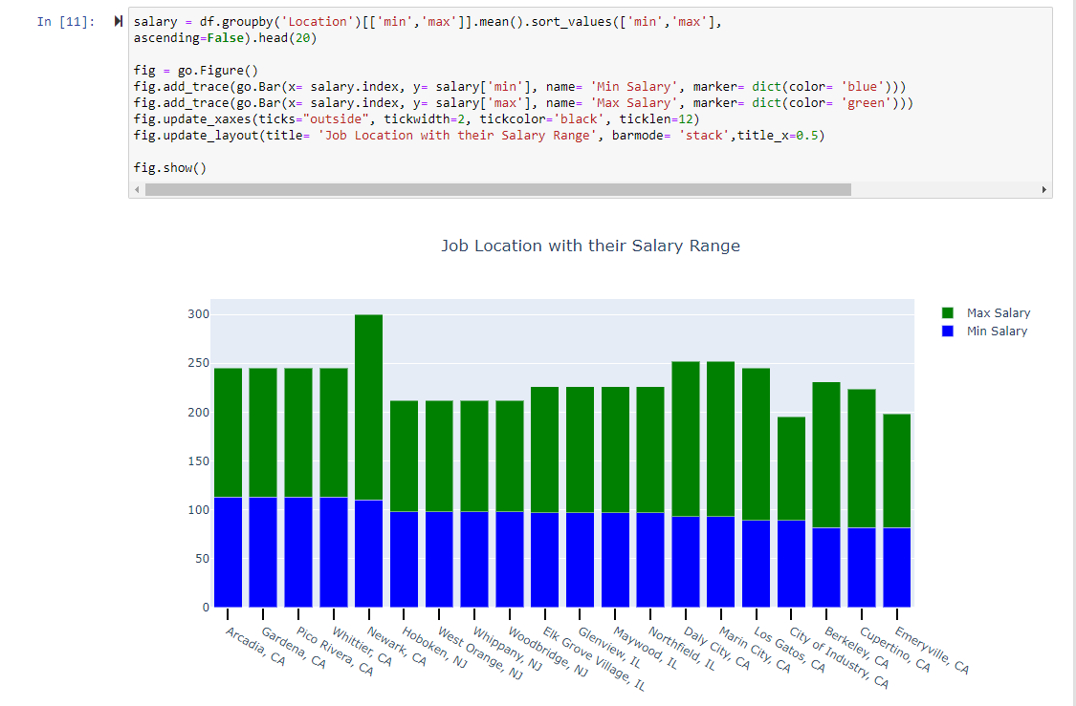
Create Visualizations
Notes:
Use python in jupyter notebook to gain insights into the data before creating website. We were able to gather various insights from the data which we displayed in the webpage. Now we will go to the website

Slide 9
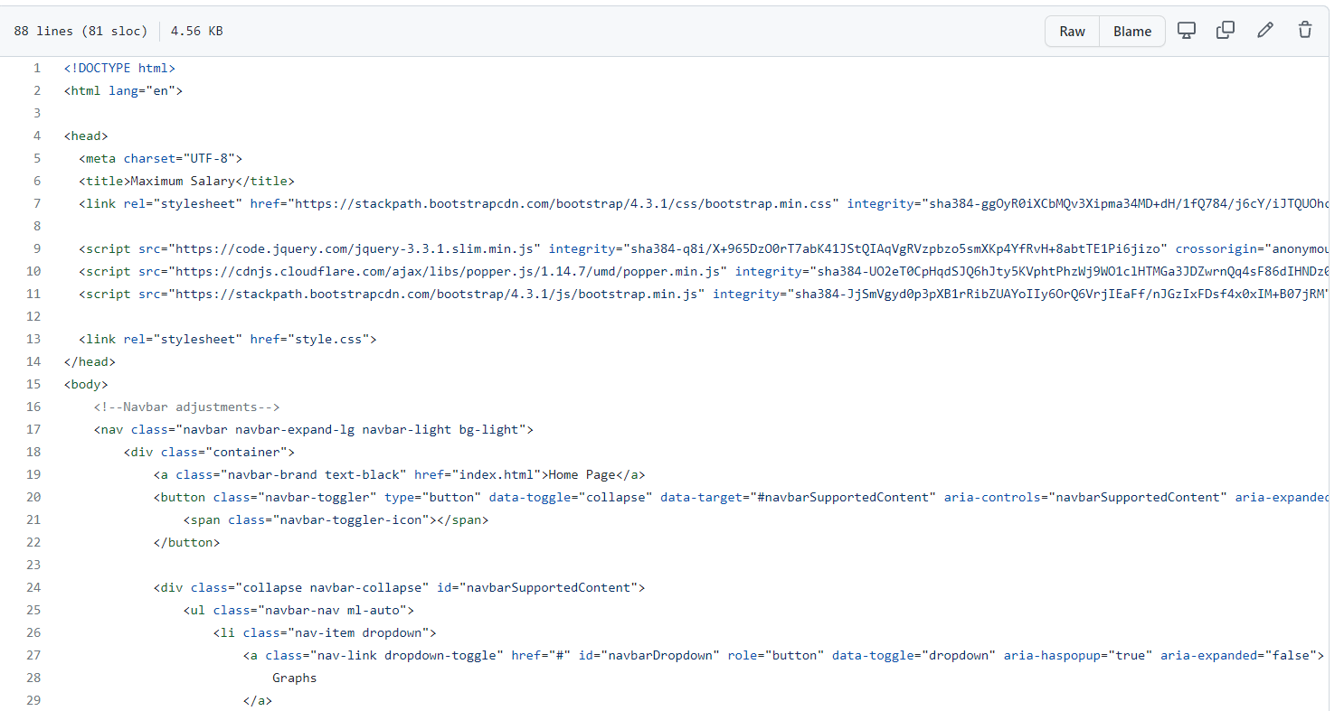
Create Webpages
Notes:
Go to web page

Slide 10
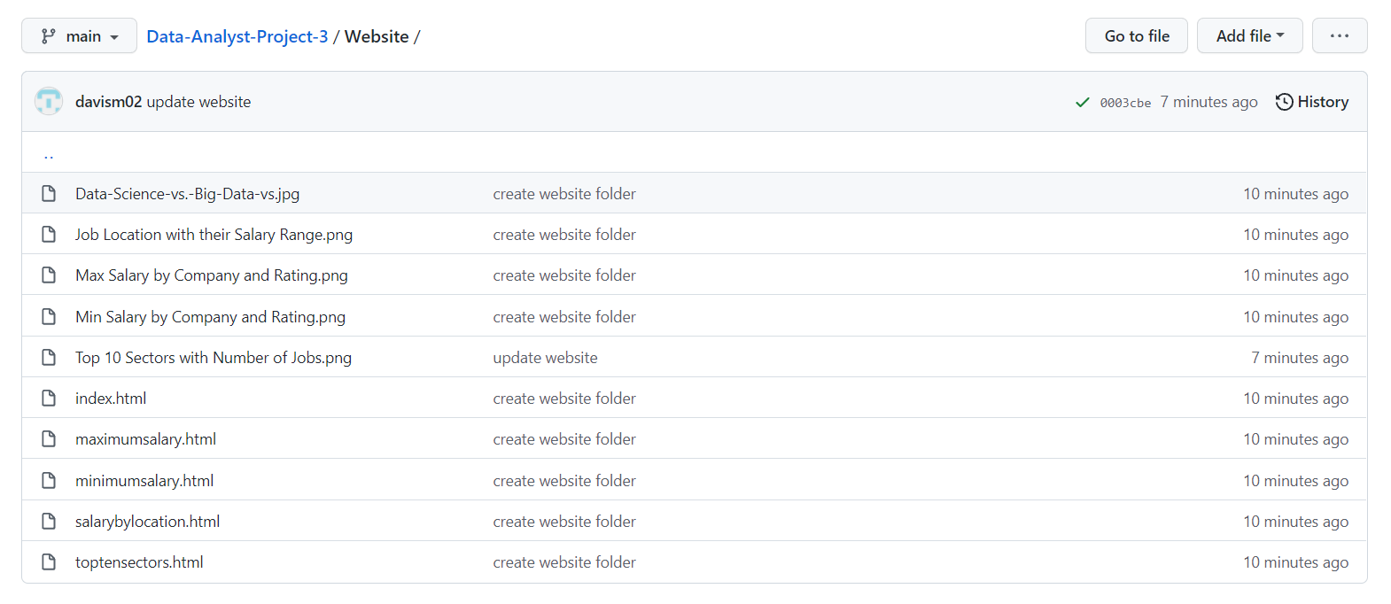
Deploy GitHub Pages

Slide 11

Data Analyst Job Market
https://davism02.github.io/Data-Analyst-Project-3/Website/index.html

Slide 12

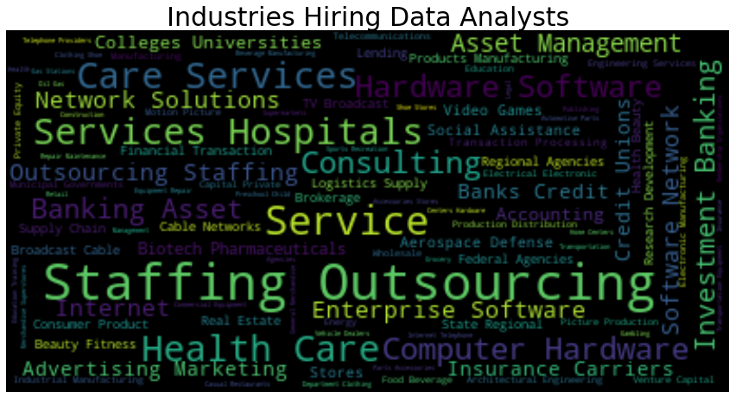

Slide 13
THANK YOU

